Slide 1

Welcome to:
Maker Training Session
5:30 PM Tuesday, March 6, 2017
Broun Hall, Room 235

Slide 2
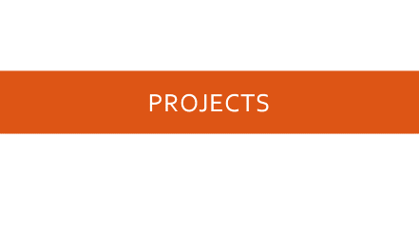


Agenda

Slide 3
About SPARC

Slide 4
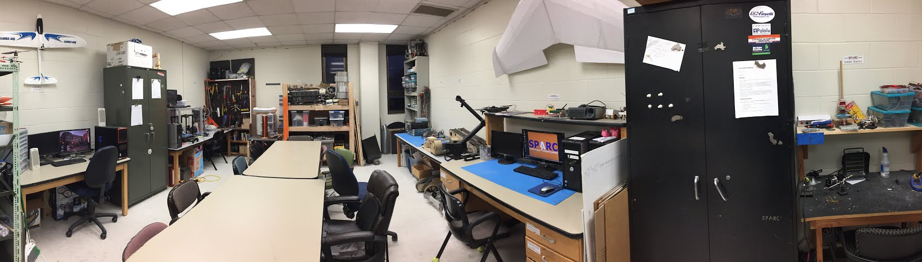
About SPARC
Creates and fosters an environment of creativity and innovation through collaborative projects.
A place to test out ideas, integrate concepts learned in class, and learn skills that will be instrumental when working in the workforce.
No prior experience is required, only a willingness to learn.
Join by logging 5 constructive hours in the lab on clipboard next to door and email sparc.auburn@gmail.com.
Lab:
- Broun 367
Maker Training Session:
- Tuesdays @ 5:30 in Broun 235
Open Forum:
- Wednesdays @ 6 in Broun 235

Slide 5


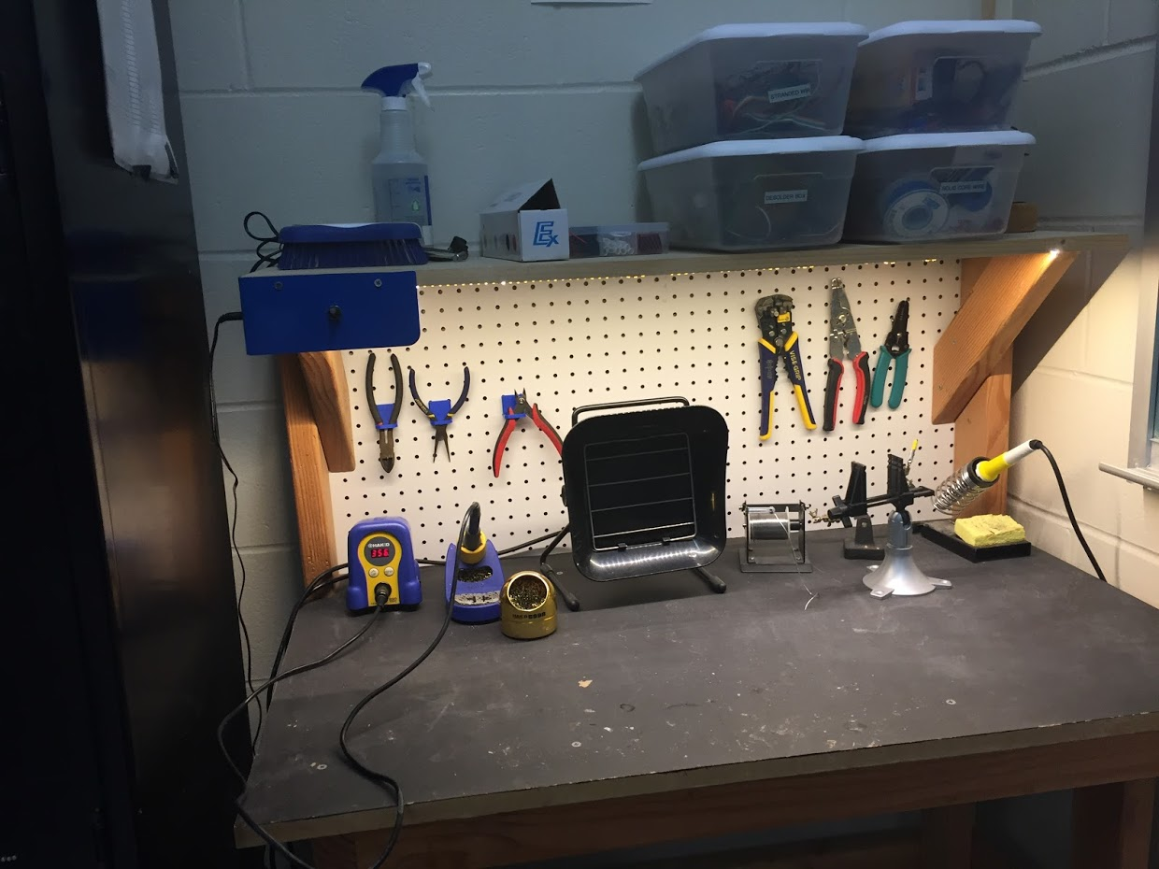
Our Lab
Broun Hall
Room 367

Slide 6
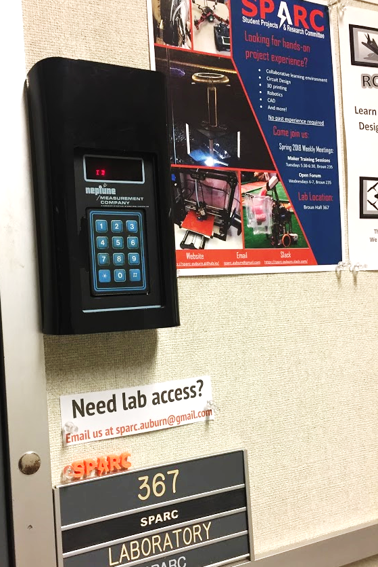
How to become a Member
Log 5 constructive hours in the lab
Write the times on the sheet on the clipboard next to the door.
Contact us at sparc.auburn@gmail.com
We will respond with the instructions to get an access code.

Slide 7
SPARC Meetings
Open Forum
Discuss status of active projects
Learn about and discuss specific topic in the realms of technology, engineering or making.
Wednesdays at 6:00 PM
Maker Training Session
Learn about a specific skills like 3D printing, CAD, electrical prototyping, and robotics.
Centered around SPARC Sumo Bot Competition
Tuesdays at 5:30 PM
Project Meetings
Project members come together to talk about detailed progress.
Meeting times and locations vary from project to project.

Slide 8




More Information about SPARC
Website
http://sparc-auburn.github.io/
Github
https://github.com/SPARC-Auburn
Slack
https://sparc-auburn.slack.com/
Email
sparc.auburn@gmail.com

Slide 9



Partner Organizations
NASA Robotics Mining Competition Team
President: Jeremy Frasher <jjf0010@auburn.edu>
RC Hobbyist Club
President: Craig Legrand <cbl0019@auburn.edu>
Meets on Mondays 3:30-4:30, SPARC Lab
Fridays 3:30-5:00, Broun 235
IEEE Auburn University Student Branch
President: Michelle Kniffen <mek0027@auburn.edu>
Meets on announced Mondays, Broun 238

Slide 10
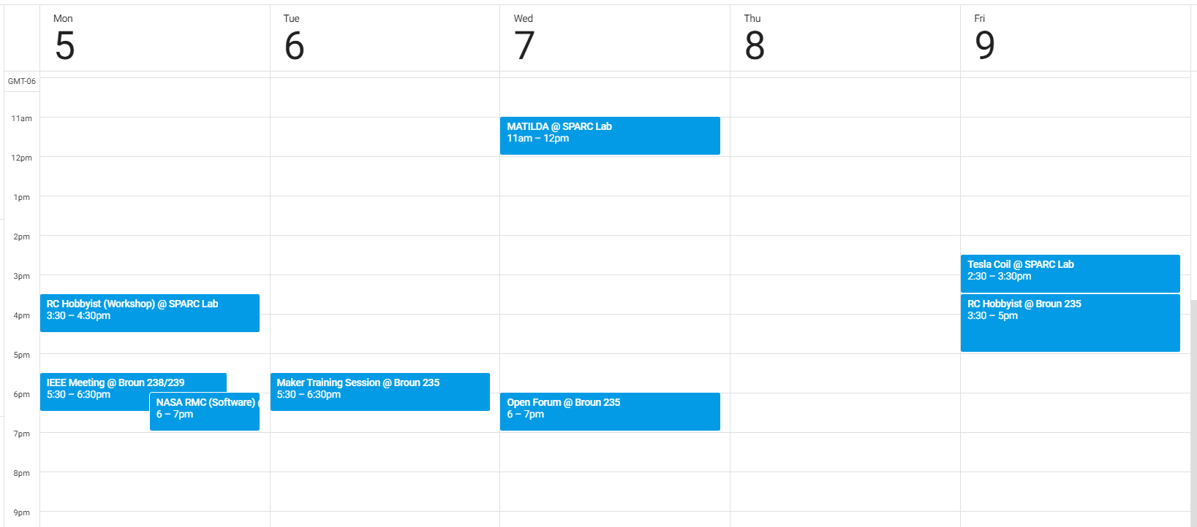
Meetings this Week

Slide 11
Outreach

Slide 12
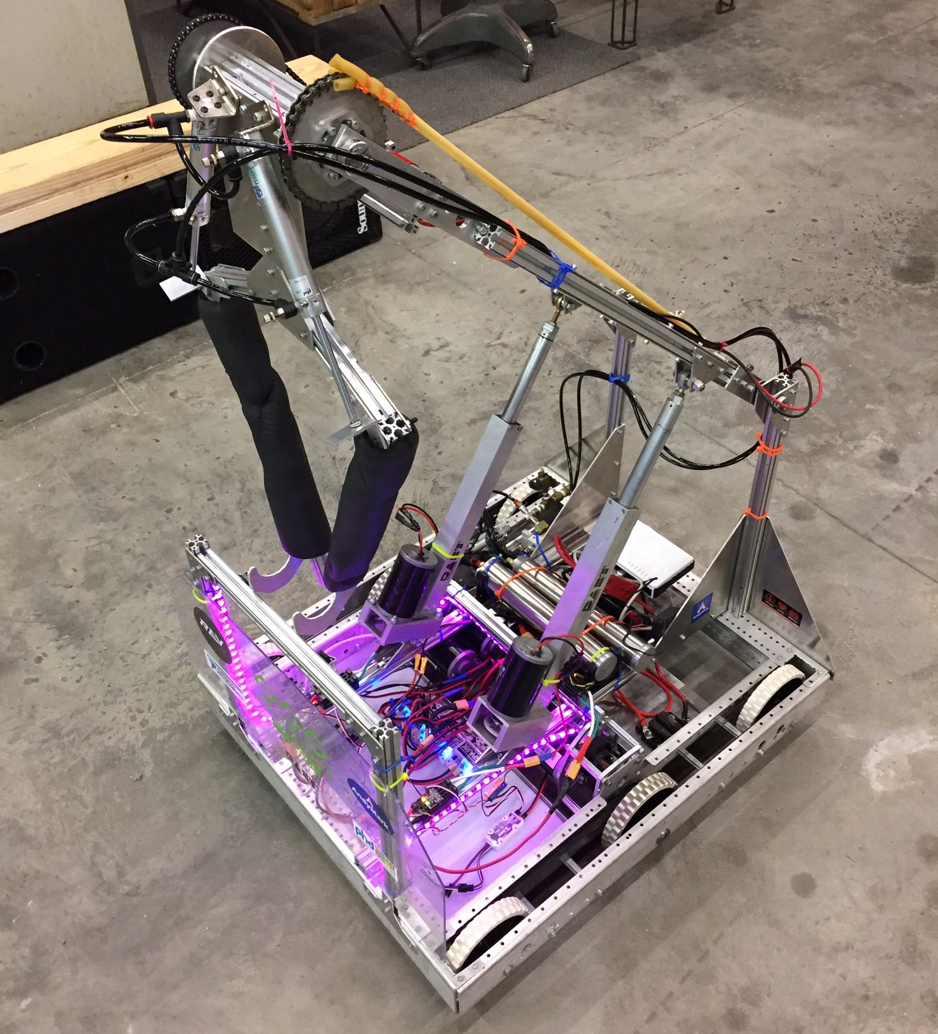
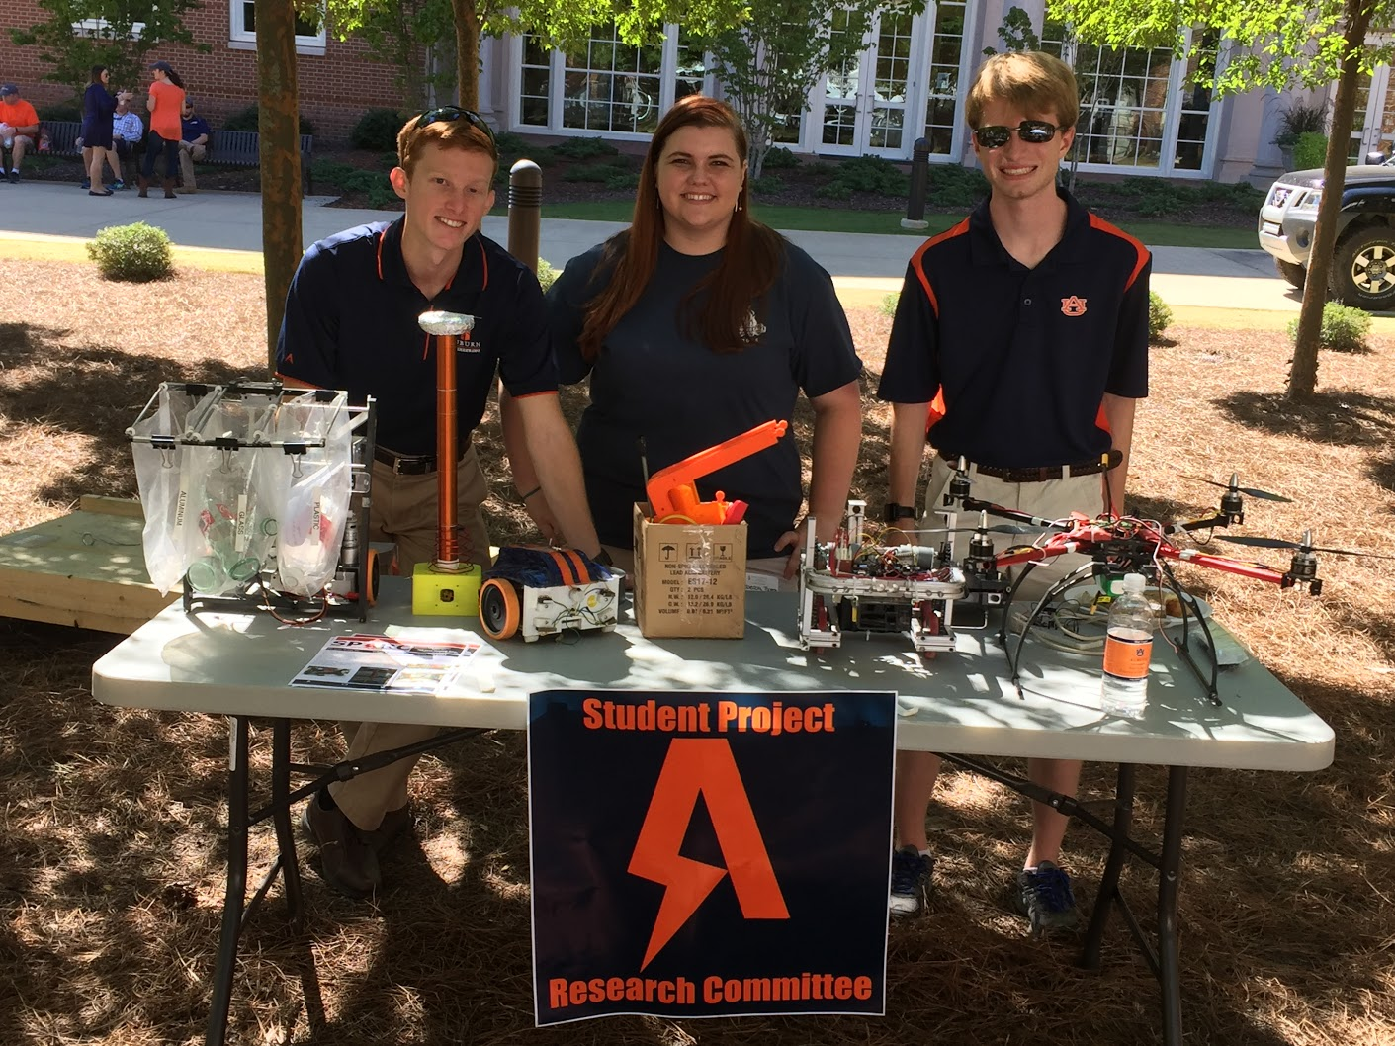
Outreach Events
Opelika HS FRC Team
Help mentor a FIRST Robotics Competition (FRC) Team
Mon Tue Thu: 3:30-6:30, Fri: 3:30-9:30, Sat:10-6
E-Day
Help display projects in Broun, Student Center, and Concourse to high school students.
Friday, February 23rd
Robot in 3 Days 2018 Bot
Engineering Tailgate 2016 SPARC Table
Notes:
Fall 2016
Loachapoka Robotics Mentoring- Mondays, Tuesdays, and Thursdays 3:00PM to 4:30PM
ECE Minority Presentation- November 14th
AJHS E-Day- November 17th
South’s Best- December 3-4th
SCORE Claw Machine- December 3-4th
Spring 2016
E-Day- Late February or early March
SPACE Day- Possible Event Next Semester
IEEE Sumo Robotics Competition (with local middle and high schools)- Spring 2017

Slide 13
Projects

Slide 14
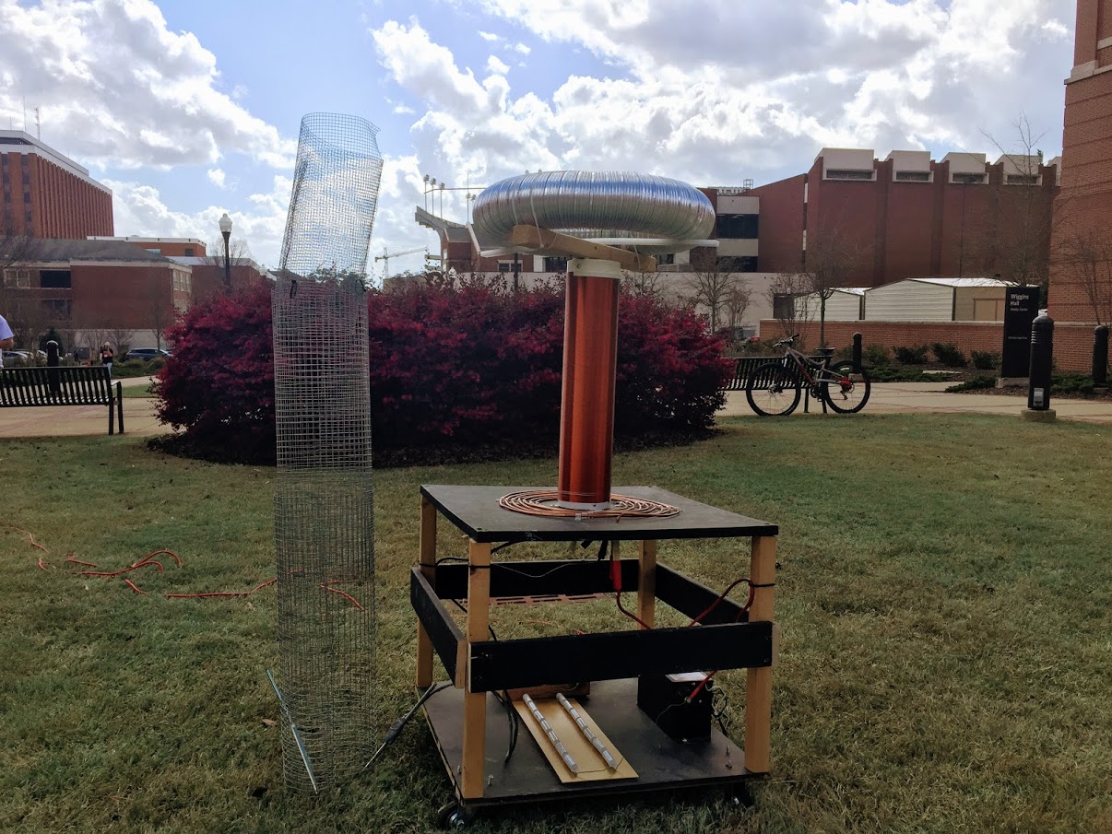
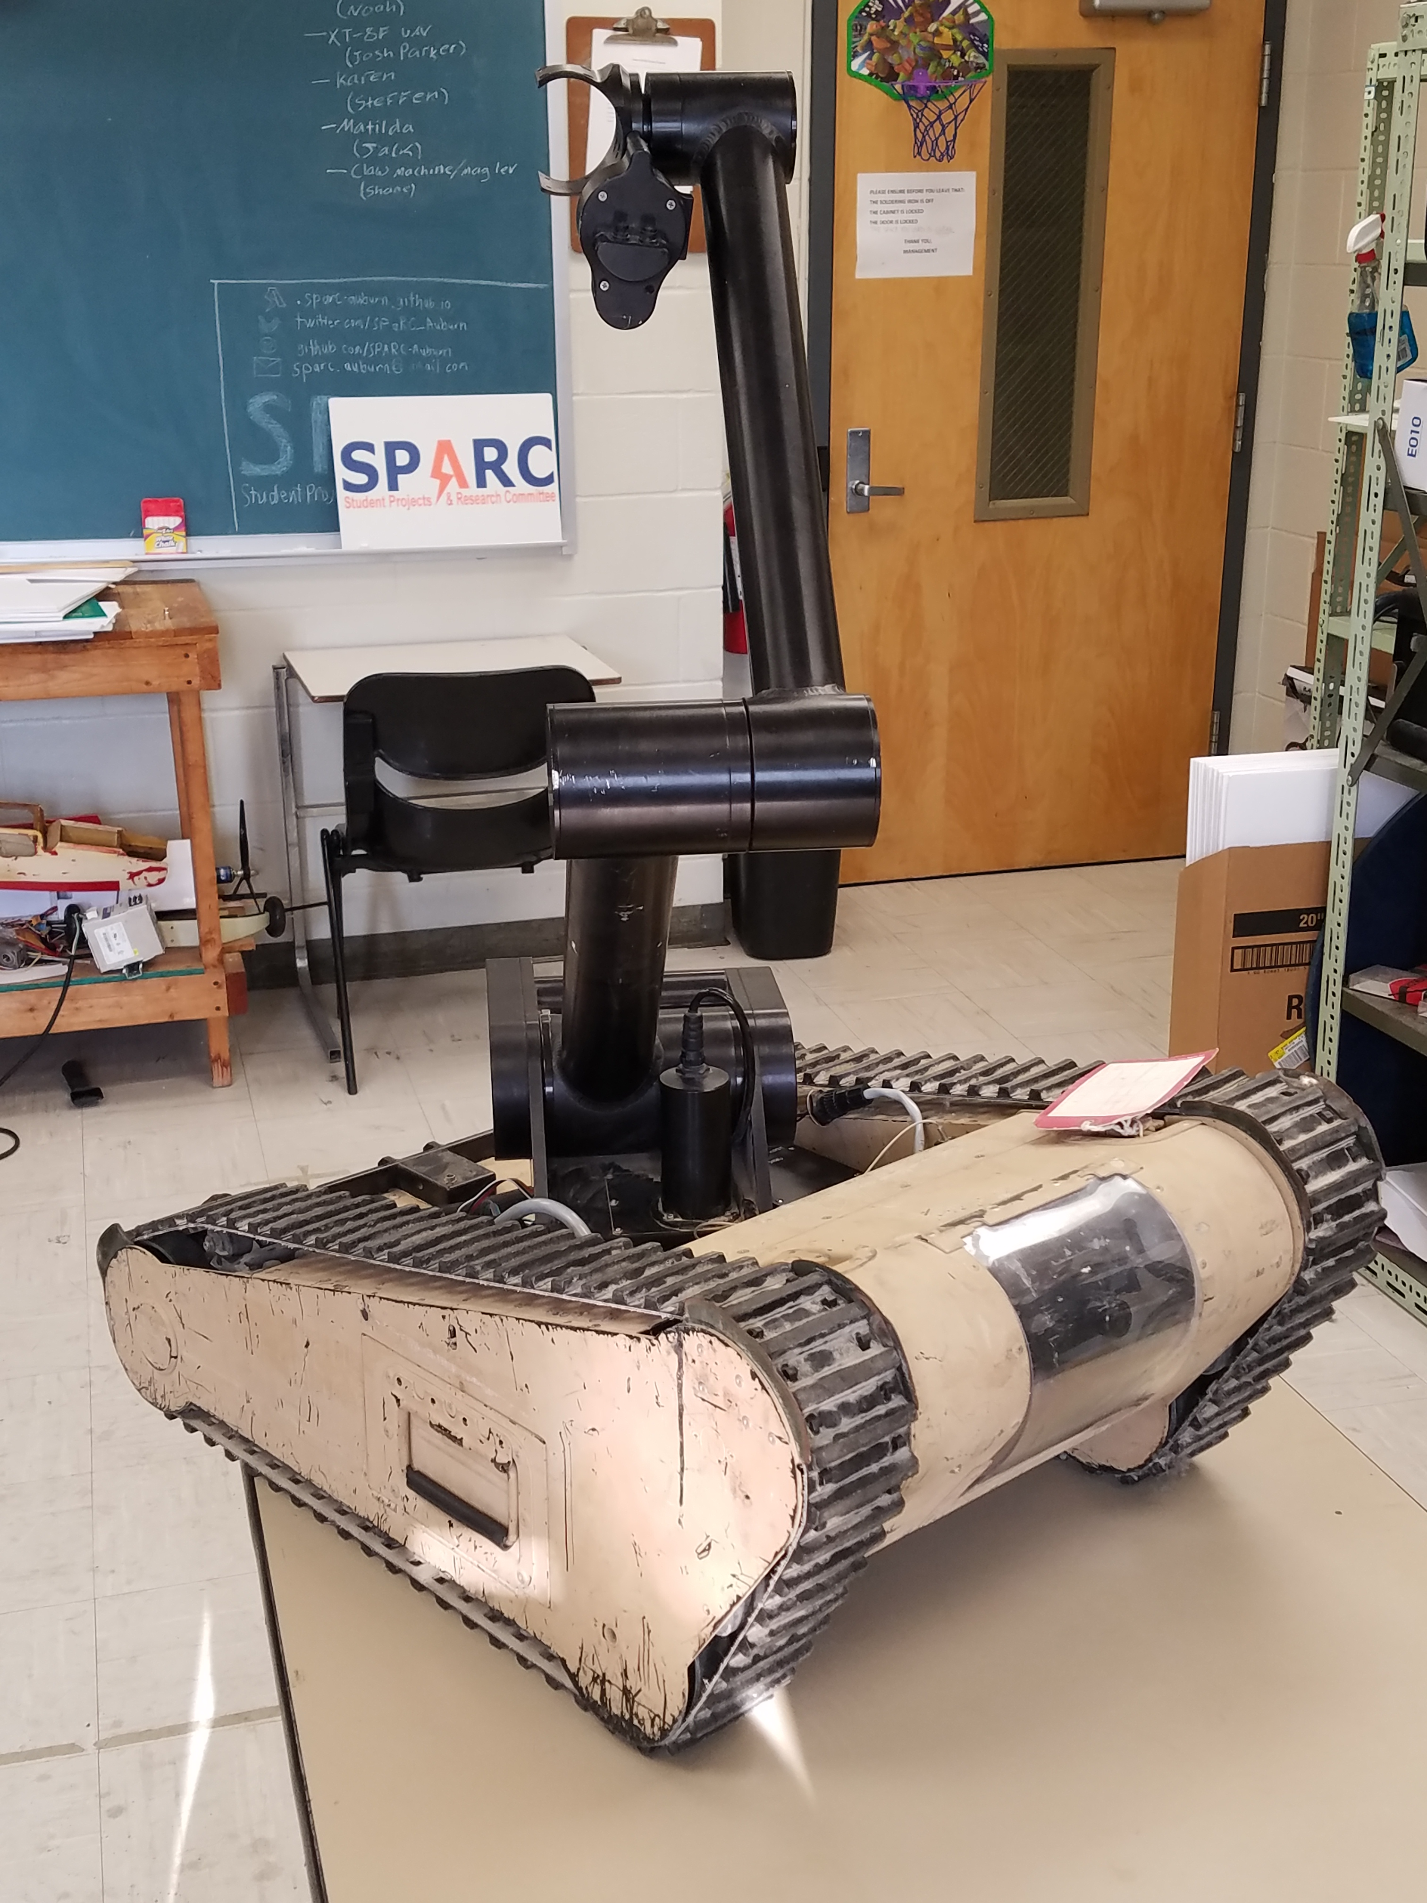
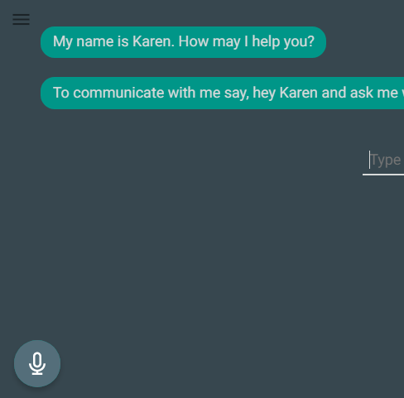
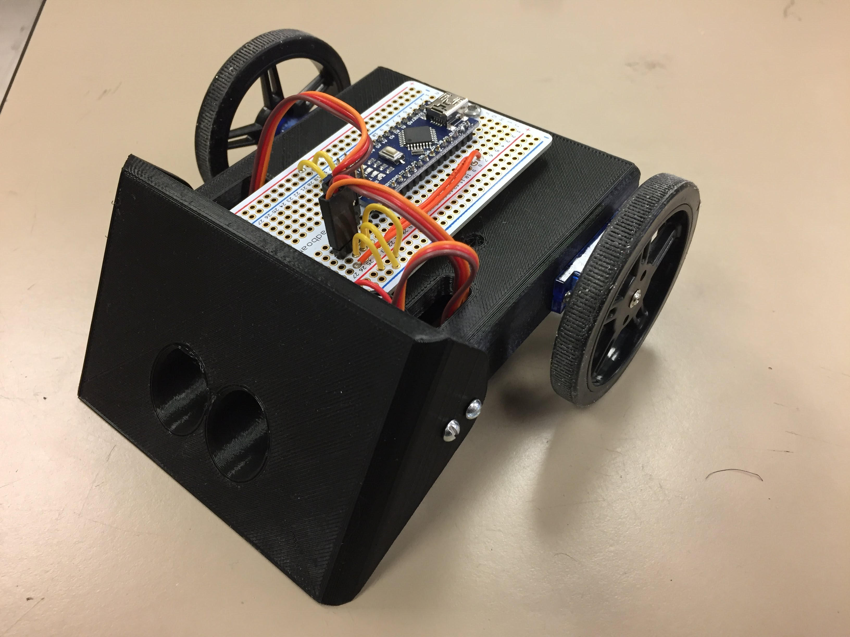
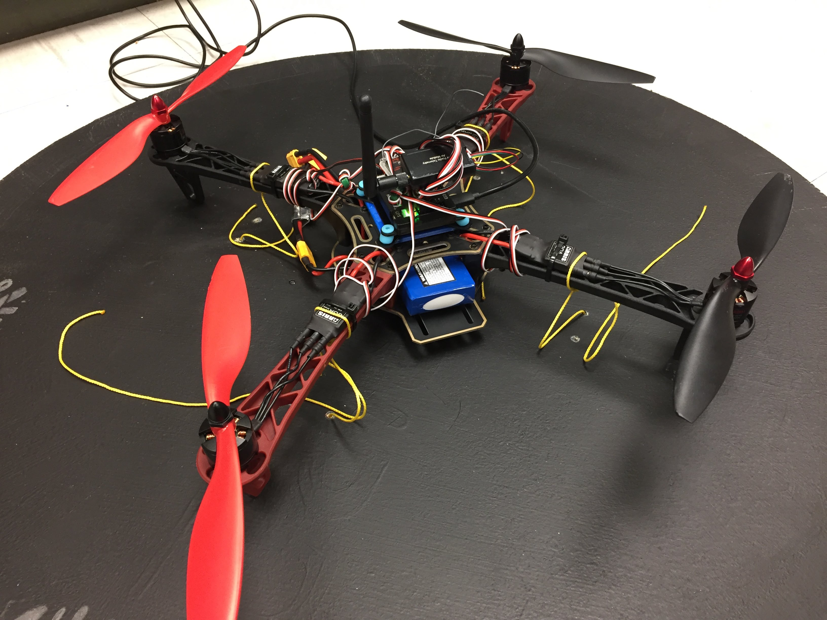
Spring 2018 Main Projects
MATILDA Robotics Platform
Tesla Coil
Lab Assistant
Lab Assistant
Unmanned Aerial Systems

Slide 15
Project: MATILDA
Project lead: Jack Thomas
Slack Channel: #projectmatilda
MATILDA stands for Mesa Associates' Tactical Integrated Light-Force Deployment Assembly
A bomb disposal robot from Dr. Roppel’s research lab.
Is in disrepair both electrically and mechanically.
Semester Focus
Reestablishing mobility.
Reestablish arm control
Meeting Time
Wednesdays at 11:00 AM in SPARC Lab

Slide 16
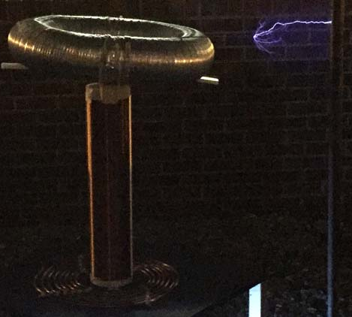
Project: Tesla Coil
Project lead: Josh Jablonowski
Slack Channel: #projectteslacoil
Demonstrated Tesla Coil at Spring 2016 E-Day
Use spark gap style circuitry
Generated estimated 400,000 volts of electricity.
Semester Focus:
Make it operational again (new capacitors)
Potentially convert it into a musical Tesla Coil.
Meeting Times
Fridays at 2:30 PM in SPARC Lab

Slide 17
Project: Unmanned Aerial SysTems
Project lead: Mike Petry
Slack Channel: #projectuas
Partnership with RC Hobbyist Club
SPARC owns two quadcopter frames.
Will be used to experiment with many applications
Autonomy- search and follow
Camera Gimbal- stable video capture
Payload- pickup, identification, and delivery
Semester Focus
Get at least one frame flying
Start looking into camera gimbal
Meeting Times
TBD

Slide 18
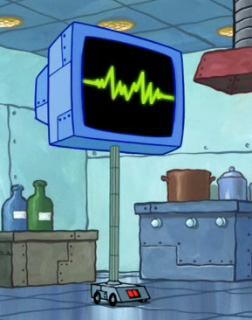
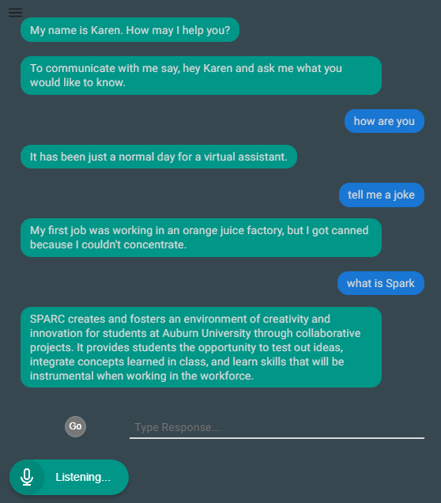
Project: Lab Assistant
Kinematic
Autonomous
Robot
Enriches
Newcomers
Create an automated lab assistant.
Will be voice controlled.
Will consist of both a stationary and mobile system.
Will be embedded on the new group chat system Slack.
Programmed in Node.JS (Framework of JavaScript)
Semester Focus
Solidify base framework
Create device/client server control mechanism
Slack Channel
#projectlabassistant

Slide 19
Project: Sumo Bot Tournament
Project lead: Matthew Castleberry
Slack Channel: #projectsumobot
Will be the final project for the Maker Training Sessions.
Attendance at Maker Training Sessions are not required to compete.
Will utilize many different topics in engineering
mechanical design
3D printing
electrical prototyping
sensor and control systems
C programming
Meeting Time
Tuesdays at 5:30 PM in Broun 235

Slide 20
Sumo Robotics Tournament

Slide 21
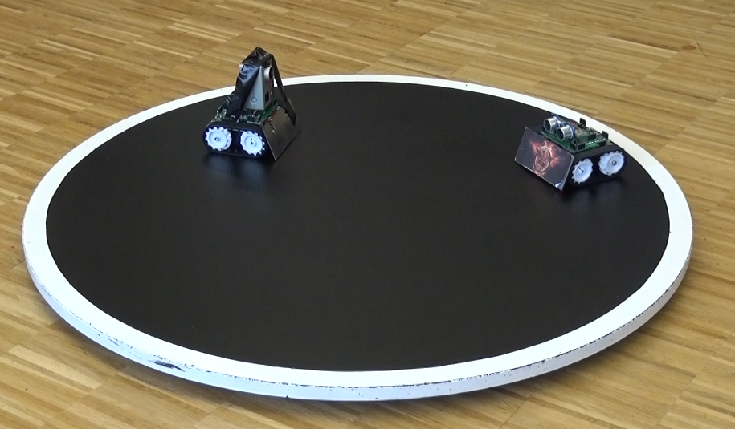

What is a Sumo Bot Competition?
Two robots are placed in a ring
Goal: attempt to push each other outside of ring.
Typically autonomous
First robot that touches outside of the ring loses the round.
The competitions “are non-destructive, family friendly, and great learning experiences.”
Competition will be on April 17, 2018 at 5:30PM
More information: http://www.robotroom.com/SumoRules.html
https://mcuoneclipse.com/2014/12/21/sumo-with-gopro-and-other-sumo-videos/
Mini Class
Japanese Class

Slide 22

SPARC Sumo-Bot Competition
Weight Constraint: < 750g(1.65lbs)
Size Constraints (at start of round)
Width: 15cm (5.91”)
Length: 15cm (5.91”)
Height: $∞$
Robots must not
Emit smoke or fire
Leak, stain, or soil
Disperse powder, grit, or grime
Spray, throw, or use projectiles
Jam, shock, or electromagnetically interfere
Snare, entangle, or employ nets/rope
Scratch, gouge, or scrape
Have sticky/magnetic/suction wheels
Competition Date:
Tuesday, April 17, 2018
5:30 PM in Broun Hall
Teams
Teams can consist of 1-3 members

Slide 23
SPARC Competition Part Constraints
up to 3 micro continuous servos
up to 2 servo wheels
all mechanical frame must be 3D printed
no sheet metal or raw plastics allowed
use any screws, nuts, washers
use Arduino Nano (clones), protoboard, wires, etc.
up to 2 Ultrasonic sensors
up to 4 line following sensors

Slide 24
Maker Training Session: Microcontrollers and Arduino

Slide 25
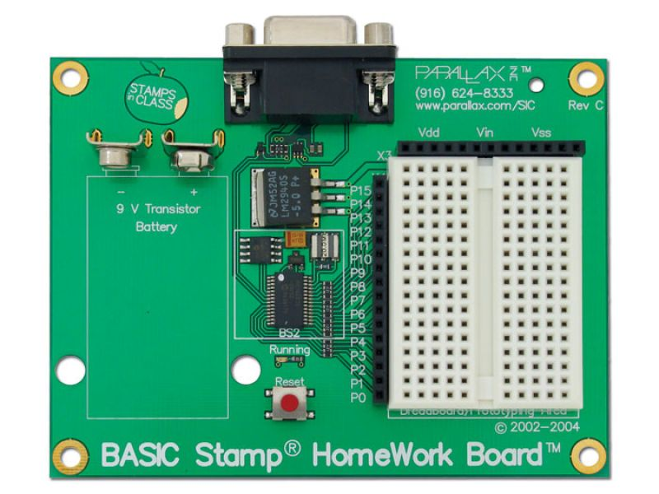

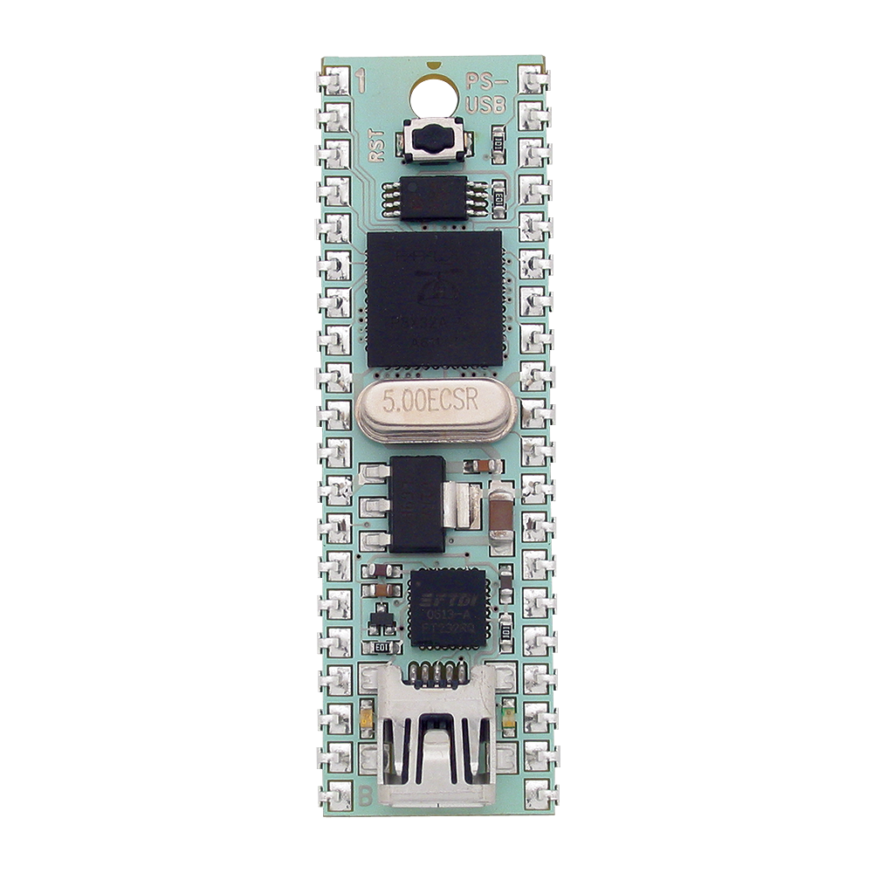
What is a Microcontroller?
A microcontroller is a simple computer on one Integrated Circuit
More economical than traditional computer boards
Are incapable of running a full operating system but can be programmed with simple programs.
Are found in many everyday electronics such as cars, toys, and appliances.
Are relatively easy to use with electrical circuits.
Parallax Basic Stamp
Arduino Uno
Parallax Propeller

Slide 26
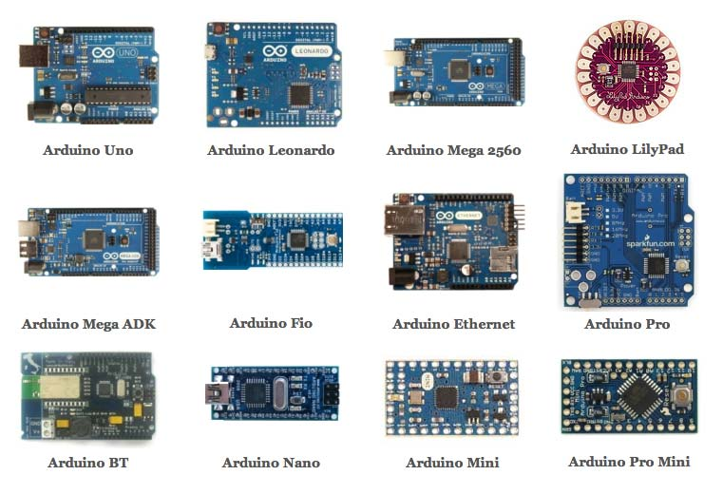
Types of Arduinos

Slide 27

Programming an Arduino
Can be programmed over USB from a computer
Uses the free Arduino IDE software
https://www.arduino.cc/en/Main/Software
Programmed in Arduino C
Has an extensive library with plenty of documentation and examples

Slide 28
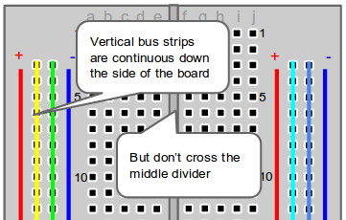
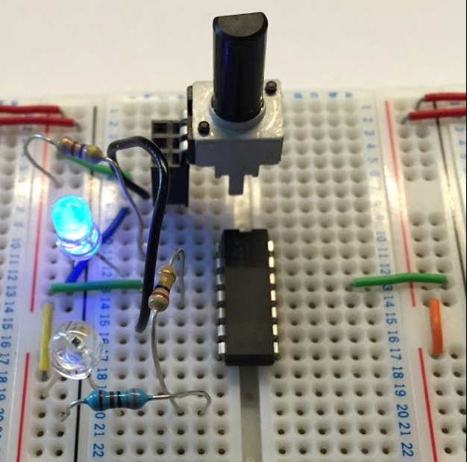
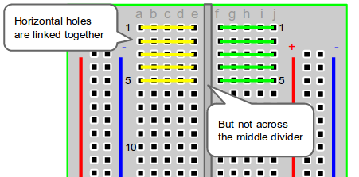
Using a Breadboard

Slide 29
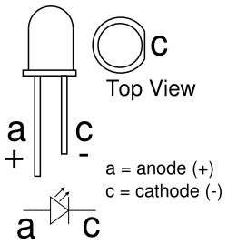
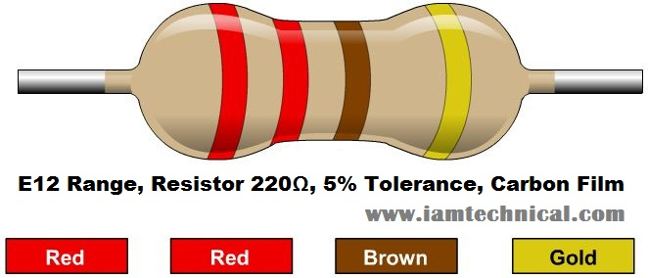

Blink an LED
It is the “Hello World” of using a microcontroller.
Connect the anode of the LED to the digital I/O pin # 13 on Arduino with a 220Ω Resistor in series.
Connect the cathode of the LED to ground (GND)
Useful Commands:
pinMode(pin, OUTPUT/INPUT);
digitalWrite(Pin, HIGH/LOW);
delay(milliseconds);

Slide 30
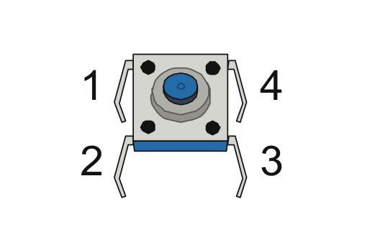
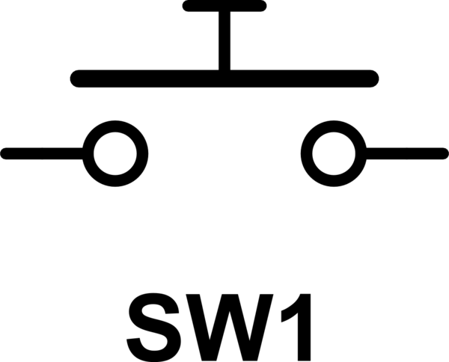
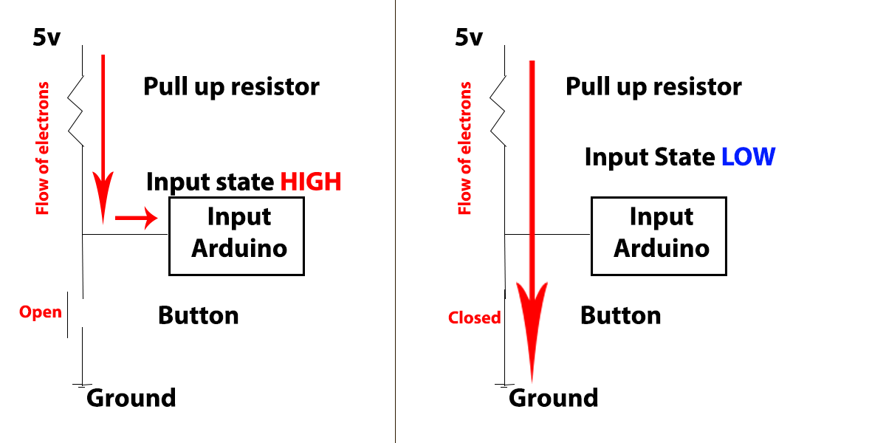
Use a Push Button
Example of Digital Input
Connect a 10kΩ resistor (Brown,Black,Orange) from the 5V to one side of the push button.
Connect IO pin 2 to the same side
Connect the other side to GND
New Commands:
INPUT_PULLUP
Serial.begin(9600);
digitalRead(pin)
Serial.println(output);

Slide 31
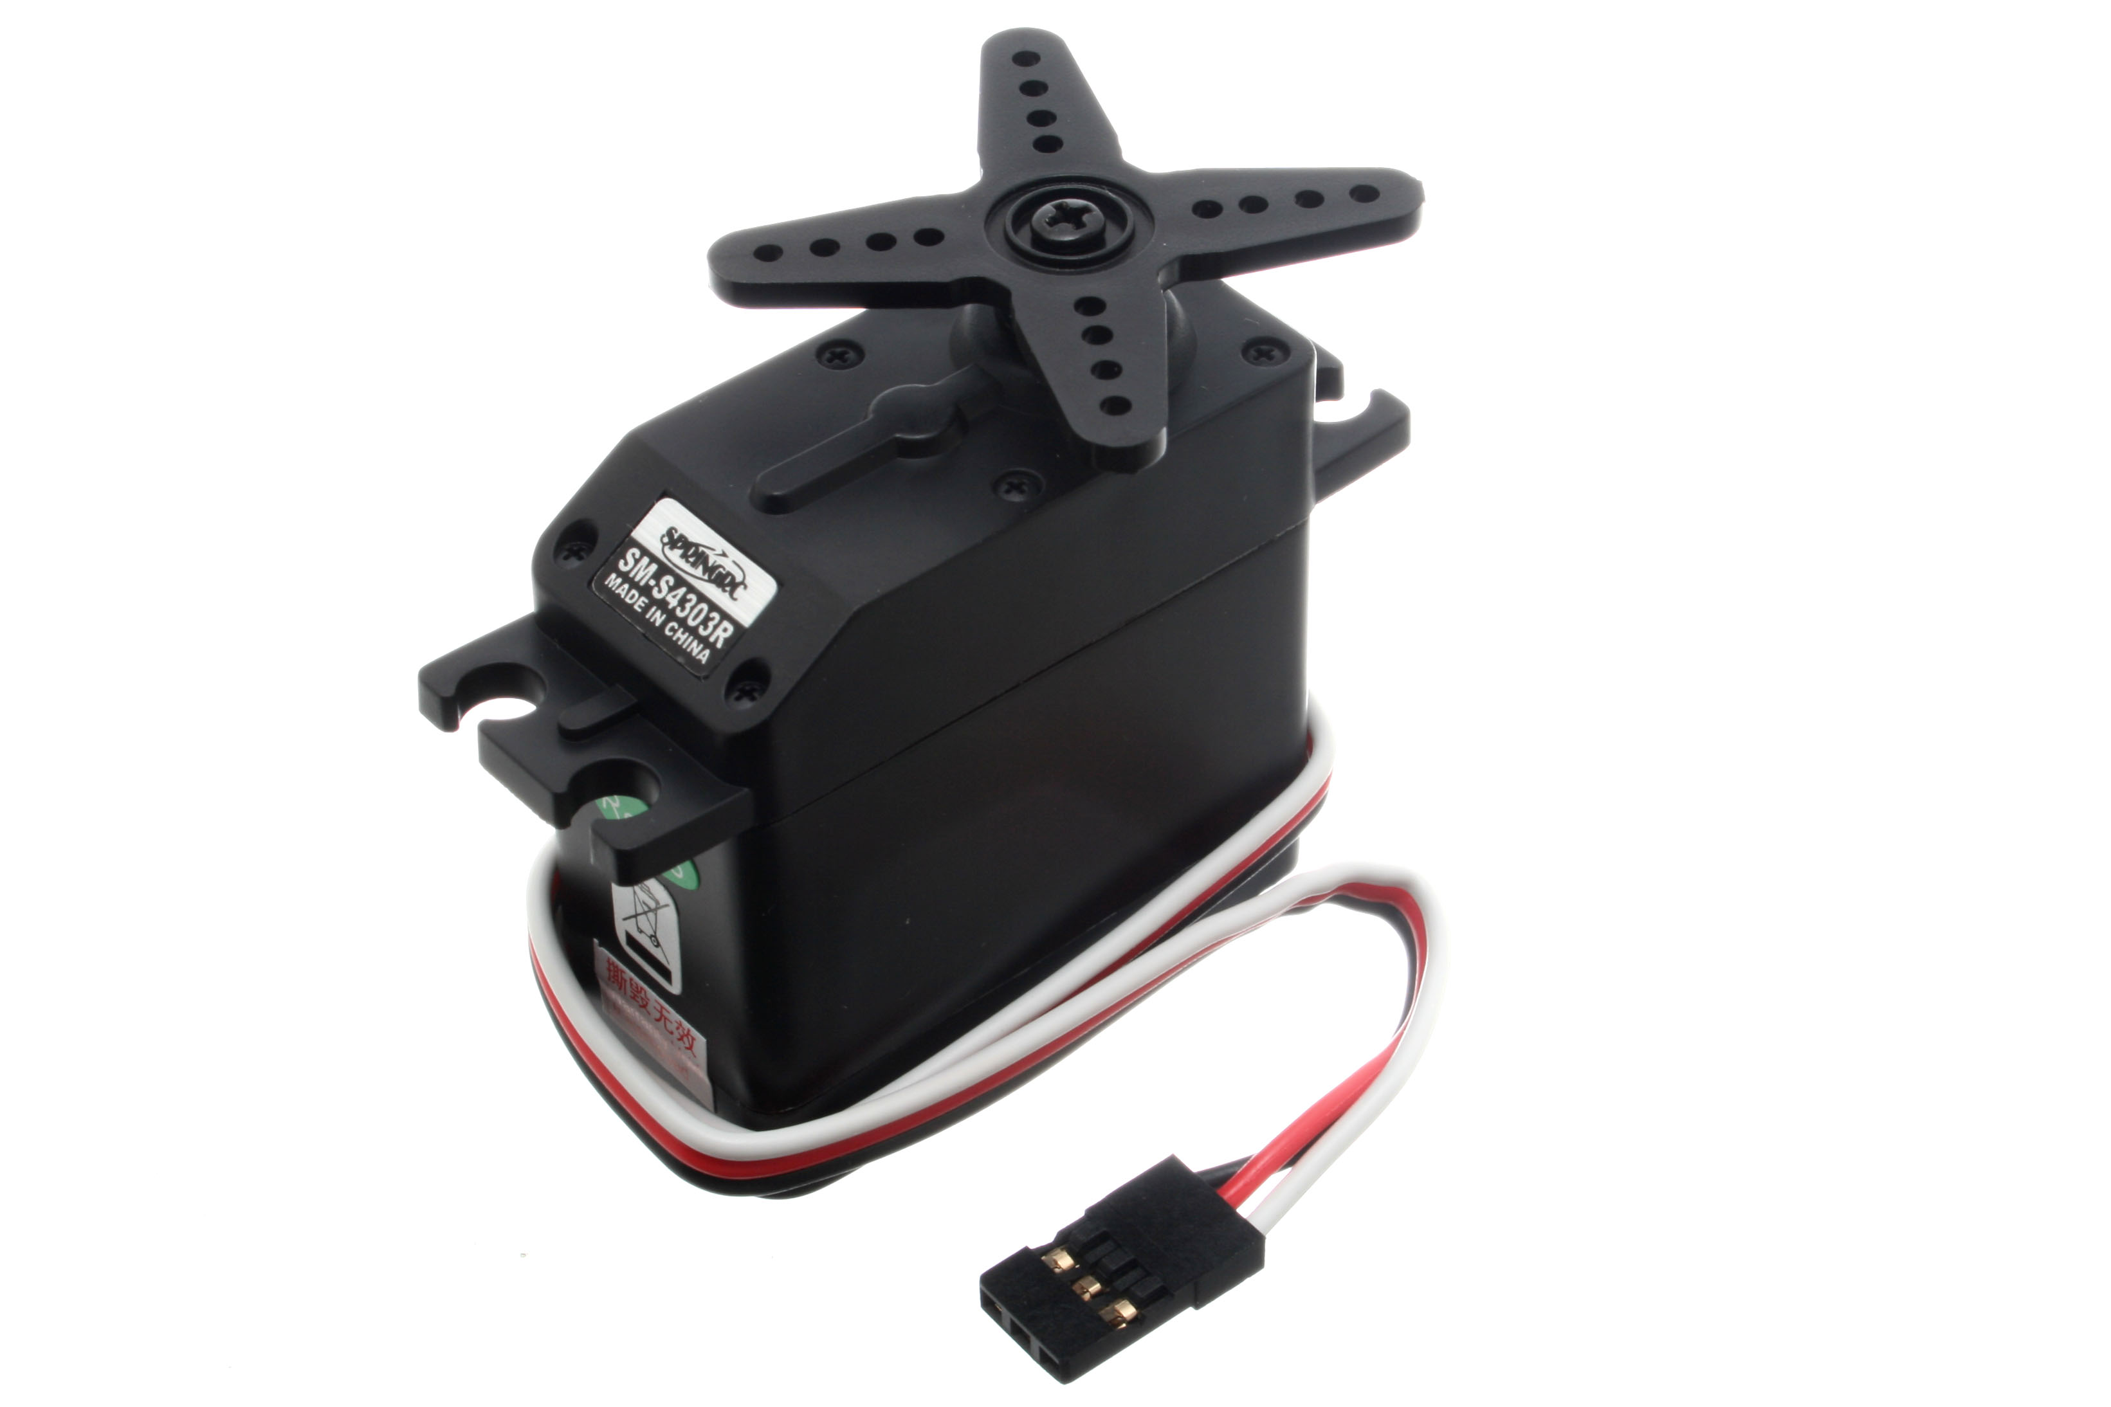
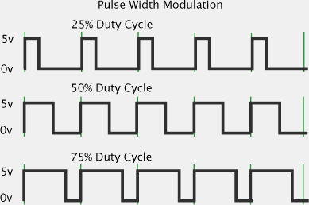
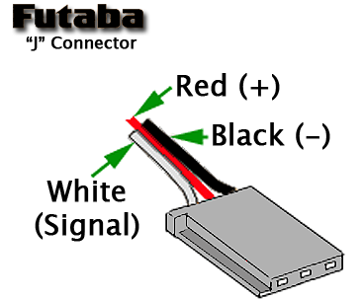
Using Servos
Example of Pulse Width Modulation
PWM is used to simulate analog signal with digital signal
Come in two main forms
Standard (180 degrees)
Continuous
Typically use a 3 pin connector
Connect white to D3
Connect red and black to 5v and GND respectively
New Commands:
#include <Servo.h>;
myservo.attach(pin);
myservo.write(integer 0-180);

Slide 32
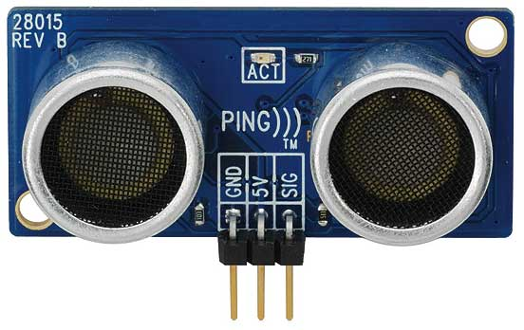
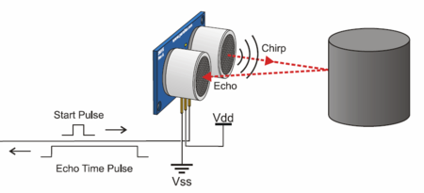
Using an Ultrasonic Sensor
Works like echolocation
Uses PWM to send out a super high pitched noise.
Detects the noise and relays the delay to the microcontroller
The distance to an object can be calculated by dividing the delay by the speed of sound by 2.
Connect to Pin 7
Use Program from Examples>Sensors>Ping

Slide 33
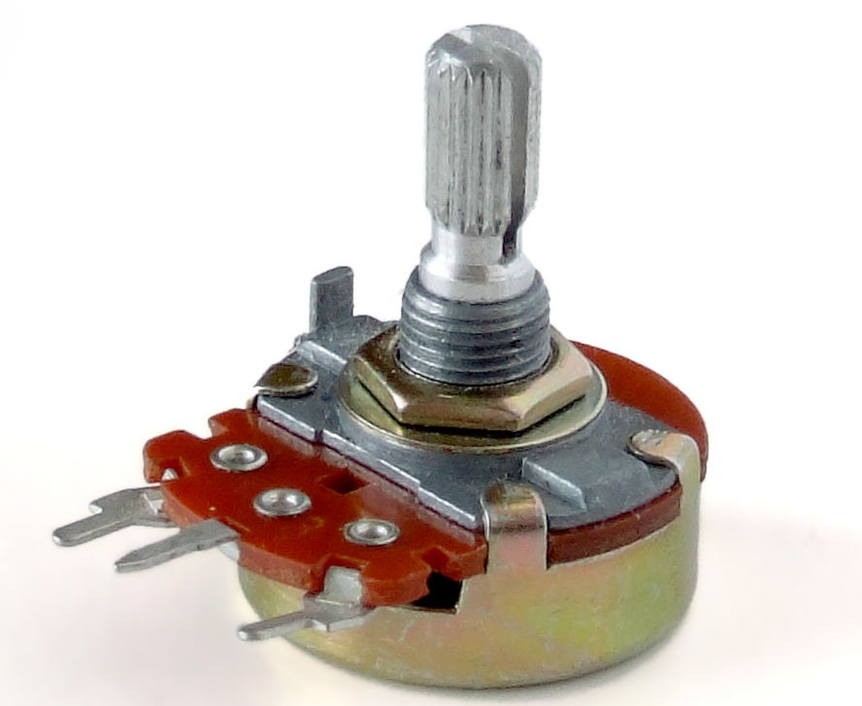
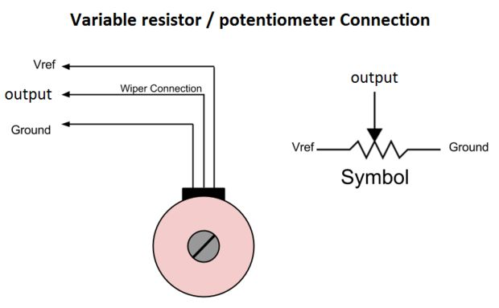
Using a Potentiometer
Example of Analog input
Is a variable Resistor
Is commonly used for volume control knobs
Used for inputting a variable value into the Arduino.
Connect center pin to A0
Connect an outer pin to 5V and the other to GND
New Commands:
analogRead(pin);

